Slide 1
HTML/CSS
MCNDHS
Ms. Eng

Slide 2
AIM: WHAT IS HTML AND THE STRUCTURE OF THIS CLASS?
Do Now:

Slide 3
WELCOME!
*This class will teach you three following things:
Web design basics
Design techniques
Development

Slide 4
GRADING POLICY
Part 1:
1) On-time/attendance/participation: 50%
2) Bathroom (no more than 5 minutes): 25%
3) No cellphone: 25%
Part 2:
4) Notes: 50%
5) work/exams: 50%

Slide 5
LESSON/EXAM STRUCTURE
Monday | Tuesday | Wednesday | Thursday | Friday
Lesson | Lesson | Lesson | Lesson | Exam

Slide 6
STRUCTURE OF THIS COURSE:
1) HTML: backbone of your website.
2) CSS: controlling the design of your website
3) Practical: building our websites

Slide 7

WHAT IS HTML?
Hyper Text Mark up Language (HTML)
1) web-based programming language

Slide 8

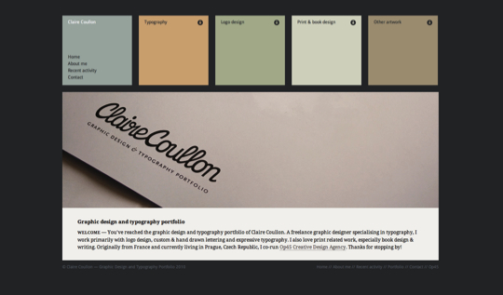
PURPOSE OF HTML
HTML is used to control the structure of a website

Slide 9

WHAT IS CSS?
Cascading Style Sheets (CSS)
1) used to adjust the designs of your webpage

Slide 10
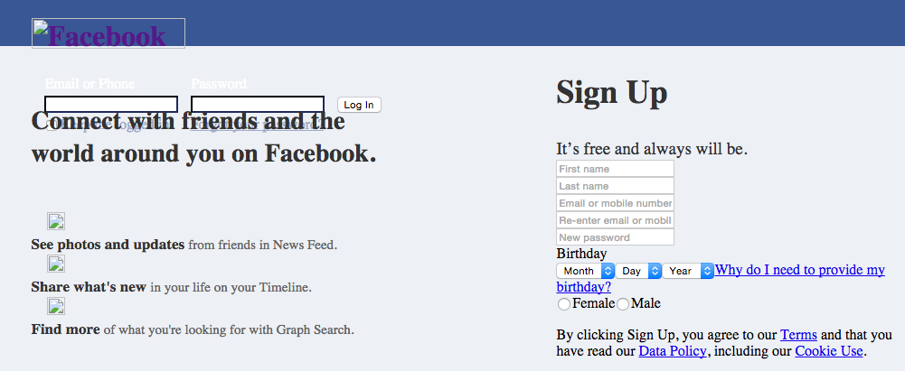
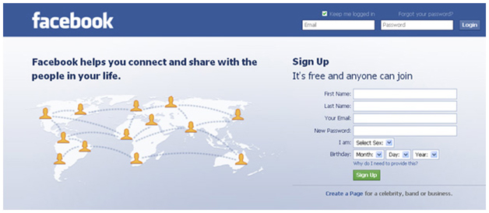
PURPOSE OF CSS
CSS can control things like the color of text, fonts, background images, etc.
before
after

Slide 11
WHY STUDY HTML/CSS?
One of the most important skills for well-paid fun jobs. (web development)
You can work part-time at home while you have a full time job. (contracted positions)
You do not learn how to code in college, you only learn concepts. (the earlier you start, the better)

Slide 12
ACTIVITY:
List three websites that you frequent the most:
Write three sentences for each.
Sentence 1: What is this website about? (content)
Sentence 2: What do you like about the structure?
Sentence 3: What do you like about the design?

